Slide 1

Configuration Management
Notes:
Created SCM Prac V1.0 11.19.2001 by J. Reyna
Updated to CM Prac Training, TR-CM-01, by J. Reyna
Configuration Management is the discipline of identifying the components of a continually evolving system for the purposes of controlling changes to those components and maintaining integrity and traceability throughout the life cycle.
Configuration Management is a formal engineering discipline which provides developers and users with the methods and tools to identify the products developed, establish baselines, control changes to the baselines, record and track status, and audit the product
Lets look at the 2nd layer of our Quality Program.
Configuration Management is the process that tracks all the updates, additions, deletions and corrections to your product and related documents.
You need this process to assure that you have the most current and best version of products identified and packaged with up-to-date documentation.
It is an activity which you need to do properly.
(Note: HAS TWO HIDDEN SLIDES - At summary and NISBS cycle. (To print student viewgraphs, de-select “Print Hidden Slides” box on print window.)
Page <number>

Slide 2
Objectives
Define the Configuration Management
discipline
Discuss the most frequently-asked questions
about CM
Provide information that helps implement CM
for both small and large projects
Provide insight into the main functions of CM, and how they are implemented
Provide resources to help you implement CM on your project
Notes:
For this class--Identify current CM capabilities and challenges

Slide 3
Common CM FAQ’s
What is CM?
Is there a relationship between Requirements and Configuration Management? Are they the same?
Why do projects need CM?
What needs to be placed under CM?
When should I place an item under CM?
What is a “baseline” and what does it have to do with CM?
What are the steps necessary to begin doing CM?
  How do you identify CM items?
  How do you control items placed under CM?
  How does the project report the status of CM-controlled items?
  How do you ensure that CM-controlled items are properly managed?
What is “Data Management”? How is it related to CM?
What if CM is performed by a contractor?
Where can I get more information on CM?

Slide 4
1. What is CM?
The Definition and Purpose of
Configuration Management
Configuration Management is a process for establishing and maintaining consistency of a product’s performance, functional, and physical attributes with its requirements, design and operational information throughout its life.
The purpose of Configuration Management is to establish and maintain the integrity of the products using configuration identification, configuration control, configuration status accounting, and configuration audits.
So...what does integrity mean?
from ANSI/EIA-649,
“The Consensus Standard for Configuration Management"
from CMU/SEI-2002-TR-012,
"Capability Maturity Model Integration, Version 1.1"
Notes:
Perhaps a less wordy definition of CM comes from the Unified Configuration Management website:
Configuration Management is the discipline of making changes in a planned and systematic fashion.
The definition and purpose both provide a pretty good description of what good CM can do for a project.

Slide 5
2. Is there a relationship between CM and RM? Are they the same?
Configuration Management implements Requirements Management
CM provides the mechanism for identifying and controlling requirements changes
  New requirements
  Deleted requirements
  Deferred requirements
  Change proposals
CM tracks the progress of requirements changes and ensures traceability to all the product components, including hardware, software, drawings, and all other supporting components
The CM Process provides a disciplined approach for receiving, identifying, tracking and resolving requirements changes – the alternative is ad hoc requirements management (otherwise known as “drive by tasking”!). CM makes RM possible!
Notes:
Your CM Process is the implementing arm of your Requirements Management Process. The orderly establishment, recording and control of Requirements changes is made possible by an orderly, controlled CM discipline.
Emergencies happen, but CM control doesn’t have to be lost? Does your project know how to address emergency changes in an orderly manner?
Question: How would be address emergency changes and still maintain CM control?

Slide 6
3. Why Do Projects Need CM?
Some of the most frustrating project problems are caused by poor configuration management:
  A defect that was corrected in document “A”, “reappears” in other documents
  A developed and tested feature is mysteriously missing
  A fully-tested program suddenly does not work
  A required change is not implemented
  The "ripple effect" is undetected
  The latest version of engineering drawings cannot be found
  The wrong versions of the configuration items are being baselined
  A required change is implemented in the wrong version of the product
  The wrong version of the product / source code was tested
  The user is given documentation that doesn’t support the version of the product they’ve received
Notes:
And this list is not complete!
More than the latest version can be found, does anyone even know what the latest version is?
You fix a bug in one release, but:
there are many releases in the field
there are other releases in various phases of development at the time
an old version is later recreated for field use for a specific customer
...
Where is the problem in when working programs no longer work?
Has something changed in the program?
Has something changed in the data files?
Has something changed in the operating system/test environment?
....
Was the wrong version used because it was misidentified/unnamed? Because the tester did not know which version was to be tested?
Traceability in CM really refers to traceability of the baselines and their contents throughout the lifecycle.
Pretty serious stuff, and I’ve seen all of these in working with clients in un-numbered applications in a dozen countries on three continents. There is no question there is a need for CM--once again, your challenge is to implement a solution appropriate to your situation.

Slide 7
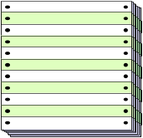

4. What needs to be placed under CM?
  Requirements specifications
  Development plans
  Architecture specifications
  Interface specifications
  Design specifications
  Developmental models
  Test plans
  Test procedures
  Test results
  User documentation
  Development procedures
  Standards
  Human-Machine Interface Spec.
  System build files
  Concept of Operations Document
  Operating systems
  Engineering drawings
  Procedure languages
  Shell scripts
  Other related support tools
  Third party tools
  Project plans
  Quality plans
  Configuration Management Plans
  Logical data structures
  User Interface files, data
  Installation / configuration files
  Compilers
Notes:
Updated 1/99 - Joe Reyna
Suffice to say that there are many artifacts created during software development and maintenance that need to be considered for some level of management and control.
The issue is to be able to identify and control those work products that have important roles in the project.
What items are under CM for your project?
In essence, what we are looking at here are work products that will be of some use to some stakeholder--for developers to document and communicate their solutions; for maintainers to support repair/enhancement of fielded systems; for customers to monitor development and to understand how to operate systems; for managers to provide visibility and means for monitoring and managing development...
Bottom line--there must be a reason for any item to be placed under CM and that rationale will drive the level of control that is required.
I will specifically mention one item that is missing from this list which is a particular hot-button of my own and that is the results from testing. These are important in the evaluation of the impact of changes to existing baselines.

Slide 8
5. When Should I place an
Item under CM?
Operational Concept or Feasibility
Study
Requirements
Definition
Operation
Product
phaseout
Statement of
Requirements
Operational
Product
Project
Initiation
Operational
test
Project
completion
Test data
Test cases
Plans
Updated
requirements
Accepted
Product
Requirements
specification
Test data
Test cases
Acceptance
test
Review
Test cases
Test data
Requirements
specification
Tested
Product
Test data
Test cases
Architectural
Design
Integration
test
Review
Test data
Test cases
Legend
Design
specification
Integrated
Product
Integration
Plan
SDLC
Phase
Detailed
Design
Integration
Walkthrough
Build
files
Tested
modules
Baselined
Phase Products
Module
designs
Tested
modules
Module
designs
Tested
modules
Module
designs
Test data
Test cases
Other Work Products
Component
Assembly
Unit
Test
Code Reading/
System Engineering
Code
Code
Code/Components
Notes:
This illustrates the products that should be baselined during the life cycle of a typical project. It’s important not only to capture a baseline, but to capture it at a point that represents a true representation of the project.
Don’t baseline a document several months after a development milestone – the document may not reflect important changes that have taken place.

Slide 9
6. What is a Baseline and what does it have to do with CM?
Baselines “freeze” configuration item development; a copy may be further altered, but the baseline remains unchanged!
Configuration baselines include (in order of appearance):
    Functional Baseline: Documentation describing a system’s or item’s functional, interoperability and interface characteristics and the verification used to demonstrate their achievement
    Allocated Baseline: Documentation describing an item’s functional, interoperability and interface characteristics, allocated from a higher-level configuration item
    Product Baseline: Documentation describing all of the necessary functional and physical characteristics of an item and the selected Functional and Physical characteristics designated for product acceptance testing and support
Configuration system technical documentation, hardware, software, and media are formally designated and fixed at a specific time during an item’s life cycle
Configuration baseline plus approved changes to that baseline constitute the current approved configuration identification
Notes:
As changes are approved incorporated, it will become necessary to re-identify the approved changed configuration. This makes the new version severable and maintainable apart from the “old” version.

Slide 10

7. What are the necessary steps to implementing CM?
TASKS:
Initiating/Planning CM
Executing CM
Controlling CM
1. Create and maintain project Configuration
Management Plan (CMP)
2. Manage implementation of CMP
3. Provide CM training
4. Perform configuration identification
5. Perform configuration control
6. Perform configuration status accounting (CSA)
7. Perform configuration audits and reviews
8. Monitor and control the CM Process
9. Objectively evaluate adherence
10. Review status with higher-level management
11. Collect improvement information

Slide 11

Identify the Supporting CM Roles
1: Create and Maintain the CMP
Project Management:
  Oversees complete fulfillment of all program requirements
Systems Engineering:
  Develops products that are placed under CM
Product Designers and Developers (along with Systems Eng.):
  Participate in the Configuration Control Board (CCB)
Component Testers:
  Confer with CM to incorporate approved changes into test documentation
Quality Assurance:
  Certify CM compliance with CMP and lower-level procedures
The CM Process has much more!!
Notes:
Let’s talk briefly about the roles of some key players in CM.
The Program Manager’s role in CM is basically oversight and management, ensuring funding and resources are made available, that tasks and schedules for CM are developed and maintained, that reports on CM activity are made and reviewed. The Program Manager or Sponsor chairs the program-level CCB, which may include other interfacing or related projects, to review Class 1 (high priority, significant impact) Engineering Change Proposals. It is vital that every project attend these CCB meetings, as these bring critical changes to light on other projects that may significantly impact your project.

Slide 12

Create and Maintain the CMP
1: Create and Maintain the CMP
Purpose of the CMP:
Ensure that all CM activities are identified, assigned and planned
Estimate resources (labor, material, facilities) required to support CM activities
Define and document how CM will be implemented
NOTE: If starting the project, ensure acceptance by the project team prior to the start of development
Notes:
To begin with, you need to plan the activities your CM group will perform. Make certain all the participants have a hand in defining the planned CM activities and reviewing and approving the documented plans and procedures you create.

Slide 13
The CMP
1: Create and Maintain the CMP
CMP
TEMPLATE
To Create the CMP:
Use the CMP Template* as a guide and tailor to the project requirements
  DO Tailor Roles and Responsibilities, Document/Report Formats, task phasing
  DO NOT “Tailor Out” the Intent, Goals and Objectives of CM!
If a project CMP exists, check it against the CMP Template to help identify CM activities that are missing or need improvement
* location: On the SSC San Diego PAL at http://sepo.spawar.navy.mil/
Notes:
The Generic CMP is the place to start, available on the SSC San Diego PAL.
The template looks comprehensive and fairly big – that’s because it addresses every area of concern for establishing CM, from identifying what you will place under CM control, to defining the processes for changing the components in a controlled, orderly manner.
(Emphasize tailoring guidelines as NOT being a blank check to remove what you don’t do, unless some business case is established and DOCUMENTED for not doing something, e.g. a function that is contracted out, and therefore documented by the contractor to perform)

Slide 14
Outline of the CMP
1: Create and Maintain the CMP
Section 1. Introduction
Section 2. Reference Documents
Section 3. Management
Section 4. Configuration Management Phasing and Milestones
Section 5. Data Management
Section 6. Configuration Identification
Section 7. Interface Management
Section 8. Configuration Control
Section 9. Configuration Status Accounting
Section 10. Configuration Audits
Section 11. Subcontractor/Vendor Control
Section 12. Review of CM Activities with Higher-Level Management
Section 13. Collecting Improvement Information
CMP
TEMPLATE
Notes:
This is the outline for the CMP – data management refers to the methods and tools you use on your project to maintain and control project artifacts kept under CM control, and interface management addresses the important integration of CM across interfacing projects, and what procedures you have in place to ensure that changes made to your project are conveyed to the interfacing projects.

Slide 15

Get Approval of the CMP
1: Create and Maintain the CMP
CMP
Submit draft CMP to project personnel for review
  Use Formal Inspection Procedure
  Ensure that project software/hardware engineers, systems, QA,
  and project management participate
Incorporate reviewer’s comments
Submit CMP for final approval
Place CMP under configuration control
Update CMP to reflect current project requirements, processes and practices as required
Notes:
Once you’ve addressed the roles these key players perform, and filled out the other elements of the CMP template to represent your project, it’s time to obtain approval.
The Peer Review Process should always be used to ensure complete review and “buy-in” by all project stakeholders to the CM process you’ve documented. Make sure all the key players are involved: software, systems engineering, QA, project management, even customer representation if possible. This helps ensure everyone is aware of their responsibility for helping establish and maintain CM on the project.

Slide 16
Manage Implementation of CMP
2: Manage Implementation of CMP
Identify the tasks to support the processes stated in the project CMP
  Develop a Work Breakdown Structure (WBS)
  Quantify budget requirements for CMP support
    (Guidelines)
    2 to 4% of total program cost
    6 to 8% of development cost
  Review CM tasks on previous programs and compare these costs with scope and complexity of the new or proposed program
Determine and document the procedures required to support the activities stated in the CMP
Define the resources and positions required to implement the CMP
Monitor the accomplishment of each task
Review tasks for compliance with the project CMP

Slide 17
Document the CM Supporting Procedures
2: Manage Implementation of CMP
CM procedures provide step by step instructions describing a course of action to be taken to perform a given process
Use Sample Procedures available from SEPO
Recommended Procedures:
Configuration Identification (CI) Configuration Change Control
Configuration Status Accounting (CSA) Configuration Audit
Corrective Action Data Management (DM)
Document Library Software Development Library (SDL)
Functional Config. Audit (FCA) Physical Configuration Audit (PCA)
Configuration Control Board (CCB) Config. Review Board (CRB)
Engineering Notebooks Internal Reviews
Product Release Training
CM
PROCEDURES
Notes:
Once the plan is in place, start documenting the “how to’s”, the Desktop Procedures that elaborate on how you will conduct CM activities in support of your project.
SEPO has recommended that you use our “Expert Mode” as a template to prepare your DTPs, and a couple of projects have used that format to create numerous Standard Operation Procedures that cover the whole range of CM tasks. Check out this list for some recommended tasks that should be addressed.

Slide 18
Implementing the CMP
2: Manage Implementation of CMP
Identify and manage resources
  CM tools
  Facilities
  Funding
  Non-developmental software/hardware
Identify and manage personnel
  Personnel to perform CM tasks
  Establish a Configuration Control Board (CCB)
  (Large projects) Establish a Data Management Group
  Training courses for those who perform the CM tasks
Notes:
A plan is good – the necessary funding, tasking of personnel, and scheduling of activities is better!
Make sure all the elements of your plan are covered by assigned personnel, by acquisition of the resources and tools necessary to perform CM functions, and that training, where required (like we’re doing here!) is provided to enable your CM crew
The CCB is the body that is charged with receiving, reviewing and authorizing all changes to the project configuration items. They stand as the only body that may approve configuration changes.

Slide 19
Implementing the CMP – Establish the CCB
2: Manage Implementation of CMP
Document the procedures for conducting CCB meetings
Identify who should be on the CCB including members from:
  Program and Project Management
  Systems engineering
  Software engineering
  Quality assurance
  Configuration management
  Independent test
  Documentation
  Hardware engineering
  Customer representative

Slide 20

Provide CM Training
3: Provide CM Training
Two types of training for the CM group and Product Development Team are recommended:
Overall CM activities training (i.e., the training you are currently taking)
  Use this training as a means for identifying specific project needs and developing appropriate CM solutions
Training on project-specific CM processes, procedures, CM tools
Notes:
Use the overall CM training as a means of finding out what your project needs (What are all the components of your project (software, hardware, documentation, tools)? Should automated tools be used?, etc.), then use these needs to tailor your CM activities to support them.
Make certain that all project personnel are trained in the Desktop procedures – they impact other project personnel, and each should know their roles and responsibilities

Slide 21
Perform Configuration Identification
4: Perform Configuration Identification
What does Configuration Identification involve?
  Selection of Configuration Items (CIs), and lower-level System Units (SUs)
  Determination of the types of configuration documentation required for each CI
  Issuance of numbers and other identifiers affixed to CIs and to the technical documentation that defines the CIs configuration, including internal and external interfaces
  Release of CIs and their associated configuration documentation
  Establishment of configuration baselines for CIs
Notes:
Project CM activity begins with the performing of configuration identification. Here are the tasks involved, which we’ll now discuss in a little more detail.

Slide 22

Configuration Identification
4: Perform Configuration Identification
Selecting Project CIs and SUs:
  Responsibility of project management
    Based on System Hierarchy
    Identify documentation for CIs
  Participation of CM in CI selection desirable
    CM provides inputs to ensure unique identifiers are assigned (e.g., apply file naming standards)
  Identified CIs placed under CM according to project CMP
Notes:
In the overview of CM, we talked about understanding the hierarchical structure of your product, and devising naming conventions that address the functionality of your product. Make sure that everything is identified, and accountable, in your CM tracking database.

Slide 23
Configuration Identification (2)
4: Perform Configuration Identification
Issuance of numbers and other identifiers affixed to CIs and to the technical documentation that defines the CI's configuration, including internal and external interfaces :
  Limit number of characters in identifiers to a maximum of 15
  Assign identifiers to CIs and component parts and associated configuration documentation including:
    Revision and version numbers where appropriate
    Serial and lot numbers
  Ensure marking and labeling enables correlation between item, configuration documentation, and associated data
  Ensure identifiers are embedded in source and object code and where contractually specified, electronically embedded in firmware
MK50-SDD-S-RA-C0
COMPASS-SW-SOM-3.1.0
A7600-TAC13TP01
MK50-SRS-S-R0-C0
Notes:
Here are some guidelines for generating a configuration nomenclature for your CI’s and supporting documentation.

Slide 24
Configuration Identification (3)
4: Perform Configuration Identification
Example 1: Document and Drawing Identifiers
Method:
CM assigns unique identifier based on pre-defined naming conventions and numbering schemes. Each document or drawing page shows identification number and applicable revision number
Examples:
“A7600-TAC13TP01”
A76 = CI Designator
00 = Revision Identifier (baseline version)
TAC13 = SU Designator by module acronym and serial number
TP = Document Type (Test Plan) or Drawing (DR)
01 = Volume Number (used only if multiple volumes)
“COMPASS-ICD-3.1A Ch Pg XX”
COMPASS = CI Designator
ICD = Document Type, or Drawing (DWG)
3.1A = Associated Version/Revision/Patch Identifier (3-1-A)
Ch Pg XX = Change Page Identifier
Notes:
Here are some examples.
Notice that each is different, yet relevant to the project – if it provides sufficient breakdown of your product’s functionality, which can assist with problem source identification and change control, then it’s enough. Don’t go overboard, but don’t be too generic.

Slide 25
Configuration Identification (4)
4: Perform Configuration Identification
Example 2: System Element Identifiers
Method:
CM identifies each CI and all project-developed support software required for development and maintenance with unique names, numbers, and version identifiers
Examples:
“A76B4.01-TAC.ET”
A76 = CI Designator
B4 = Build Number
01 = Version of working build
TAC = SU Designator by module acronym
ET = Subordinate SU designator by function (where appropriate)
“COMPASS-SW-SOM-3.1.0”
COMPASS = CI Designator
SW = Software (SW), Firmware (FW) or Hardware (HW)
SOM = Software module Identifier (Scenario Operation Monitor)
3.1.0 = Version/Revision/Patch
KEY: USE THE APPROPRIATE NOMENTCLATURE AND BE CONSISTENT!
Notes:
Consistency is important! Are the identifiers for software and supporting documentation consistent with each other? If not, might the wrong version of support documentation be used to support fielded software? (User calls me to report a “missing screen”, only to find that their User Manual is outdated, and doesn’t reflect the replacement of the “missing screen” with a new screen, as reflected in the current software version)

Slide 26
Perform Configuration Control
5: Perform Configuration Control
A - Receive CI and technical data and place them in the libraries
B - Process CI and technical data requests
C - Implement the Configuration Control Board (CCB)
D - Establish a Baseline Change Process
E - Identify change control documents and document procedures for
creating and processing them
F - Report any deficiencies against this activity or suggested
enhancements

Slide 27
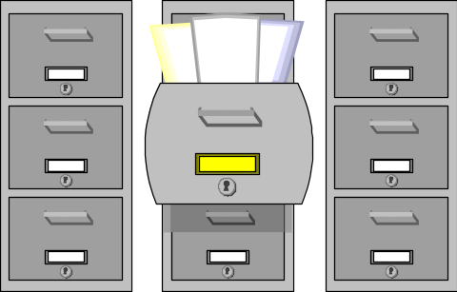
Configuration Control
5: Perform Configuration Control
A - Receive CI and technical data and place them in the libraries
  CM Libraries are established to control documentation and create repositories containing CIs and SUs
  Typically consist of three libraries:
    Software Development Library (SDL)
    and/or Engineering Notebooks
    Document Library
    Drawing Library
  The SDL and/or Engineering Notebooks comprise the controlled collection of documentation, intermediate software development products, associated tools, and procedures that comprise the Developmental Configuration CI
  The Document Library contains the hard copy and soft copy of approved baseline configuration documents (non-CI), deliverable/non-deliverable documents, and reference materials
  The Drawing Library comprises all project drawings (engineering, facility floor plans, design architecture, etc.)

Slide 28
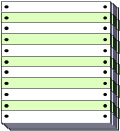
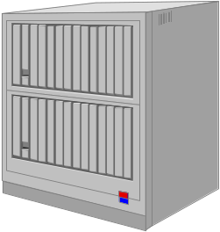
Configuration Control (2)
5: Perform Configuration Control
B - Process CI and technical data requests
  Establish procedures for the controlled request and release of CIs, associated documentation, and other project-related artifacts
  Procedures will include maintaining “check-in/check-out” logs, reporting status of segments/modules/documents that are in development or change process and who is developing the changes
  If feasible, give strong consideration to the use of automated tools for assisting with controlling software/document access and overall configuration control (example: ClearCase, Merant Dimension, etc.)
BASELINE LIBRARY

Slide 29
Configuration Control (3)
5: Perform Configuration Control
C - Implement the Configuration Control Board (CCB)
  The CCB provides formally-controlled changes to both delivered product baseline documentation and software, and developmental products, through performance of the following functions:
    Authorizes establishment of development/product baselines and identification of CIs
    Represents interests of project management and all groups affected by changes to the baseline
    Assigns, reviews, and provides for disposition of action items
    Provides required staff coordination on all proposed or reviewed changes or modifications
    Serves as a source for the coordination of technical expertise for the project.

Slide 30
Configuration Control (4)
5: Perform Configuration Control
C - Implement the Configuration Control Board (CCB) (cont’d)
    Identifies resources required for implementation of proposed changes
      Assesses impact of proposed changes upon the system
      Determines cost of proposed changes
      Determines impact of changes on development and test schedules
    Monitors design, production, and validation process for approved modifications; initiate corrective action process to ensure design compatibility and integrity, cost- effectiveness, and conformance to scheduled milestones
    Directs implementation of changes approved by the LCCB (the Local CCB - probably YOUR CCB if you coordinate with a sponsor’s higher level CCB)
Notes:
The CCB will review and approve ALL proposed changes to the system. Meetings of the CCB are scheduled based upon the volume and severity of proposed changes – sometimes an “emergency CCB” will meet at virtually a moment’s notice to address either high-priority changes or to assess the approval of a critical requirements change or problem report.

Slide 31

Configuration Control (5)
5: Perform Configuration Control
C – Implement the Configuration Control Board (CCB) (cont’d)
    Exercises interface management support and control for project CIs
    Exercises approval authority (project-level)
      Recommends approval for Class I changes
      Approves Class II changes
Class I changes affect: operational characteristics, performance weight, interfaces, or other technical requirements in the specification
Class II changes have no operational effects; and are transparent to the user
Notes:
Class I and II defined in MIL-STD-973 – notice that Class I changes affect the existing product specifications, such that if the change were approved, the specifications would have to be modified to reflect the change.

Slide 32
Configuration Control (6)
5: Perform Configuration Control
C – Implement the Configuration Control Board (CCB) - (cont’d)
  “Layered” CCBs will be required to ensure coordinated CM of
  multiple integrated systems
Program Level CCB
Example: AN/SQQ-89 ASW Suite
System CCB
System CCB
System CCB
Fire Control UFCS Mk 116
Sensors
ASW Weapons
Local CCBs:
Software (SCCB),
Hardware (HCCB)
Local CCBs:
Software (SCCB),
Hardware (HCCB)
Local CCBs:
Software (SCCB),
Hardware (HCCB)
Notes:
Understanding that there may be interfacing CCBs may help avoid duplicating approval processes for changes that have been directed by higher authority. This also helps to communicate the impact of changes on related projects.

Slide 33

Configuration Control (7)
5: Perform Configuration Control
C – Implement the Configuration Control Board (CCB) (cont’d)
  CCBs may interface with other technical control boards as appropriate:
    Technical Review Board (TRB)
    Operational Advisory Group (OAG)
    Maintenance Advisory Group (MAG)
    Interface Control Working Group (ICWG)
Notes:
Identify all the groups that are impacted by changes to the system, and ensure that communications are maintained, and representation is afforded members of groups to the CCB, and that the CCB is represented at each of these group’s meetings.

Slide 34
Configuration Control (8)
5: Perform Configuration Control
D - Implement a Baseline Change Process
  Prepare and submit the change request
  CCB and LCCB review (justify, evaluate and coordinate)
    Assign priorities - MIL-STD-498 provides detailed descriptions for priorities:
      Priority 1: Prevents the accomplishment of an operational or mission-essential capability
      Priority 2: Mission degrade with no work-around
      Priority 3: Mission degrade with workaround
      Priority 4: Minor
      Priority 5: Other
    Classify problem/enhancement categories (affects plans, concept, requirements, design, code, database/data file, test info, manuals, other)
  CCB and LCCB disposition (approve, disapprove, defer, etc.)
    CCB approves Class I changes
Notes:
The assignment of priorities refers primarily to system/software trouble reports, but can also be used to categorize requested changes to the system/software.

Slide 35

Configuration Control (9)
5: Perform Configuration Control
D - Implement a Baseline Change Process (cont’d)
    CCB recommends approval of Class I changes, LCCB approves Class II changes
    CM takes minutes of CCB meetings and archives them in the project SDL or Engineering Notebooks
  System/Hardware and Software Engineering implementation of the approved change to hardware, software and documentation
  CCB and LCCB approve baseline and approve baseline release
Notes:
The LCCB typically operates as a sub-group supporting the higher-level CCB.
If the organization is small, there are no interfaces to other projects, or the scope of the system/software is fairly limited, CCB boards for software and hardware may be combined, and further combined with the overall system-level CCB.
The key is to ensure that everyone who has responsibility in the building and maintaining of the system and its related components is involved.

Slide 36

Configuration Control (11)
5: Perform Configuration Control
E - Identify change control documents and draft procedures for creating and processing them
  Project may use some or all of the following change request forms (Refer to the CMP Template and MIL-HDBK-61A for a description of these forms and procedures for creating and processing):
    Engineering Change Proposal (MIL-HDBK-61A)
    Specification Change Notice (CMP Template)
    Notice of Revision (MIL-HDBK-61A)
    Request for Deviation (MIL-HDBK-61A)
    Local Change Request (CMP Template)

Slide 37
Perform Configuration Control (12)
5: Perform Configuration Control
F – Report any deficiencies against this activity or suggested enhancements
  CM works with QA to review CM processes and products to determine whether goals and objectives for effective CM control are being met
  When appropriate, document process changes to CMP via Document Change Requests (DCRs) to recommend improvements in the CM Process
  Coordinate planned CMP changes with your Department SPI Agent to ensure consistency with organization process (suggest improvements to the organization process, if appropriate!)

Slide 38

Perform Configuration Status Accounting
6: Perform Configuration Status Accounting
A - Establish/Maintain CSA system
B - Receive CI and technical data for entry into the CSA system
C - Generate CSA reports
D - Report any deficiencies against this activity

Slide 39
Configuration Status Accounting
6: Perform Configuration Status Accounting
  A - Establish/Maintain CSA system
    Document a database design to identify the elements that will comprise the CSA (e.g. Configuration Identifier, Description, Change Status, Location(s), Current/Archived Baseline Version(s)). MIL-STD-973, Appendix H provides suggested CSA requirements and records, Appendix I provides a recommended standard set of CSA elements
    Establish MINIMUM Data Entry requirements to establish a CI record in the CSA system
    Consider acquiring an automated CSA database tool
    Maintain control conventions for access to and update of CSA contents

Slide 40
Configuration Status Accounting (2)
6: Perform Configuration Status Accounting
  B - Receive CI and technical data for entry into the CSA system
    Establish the technical data necessary to update the CSA system
  Example (Required Data Elements for a Trouble Report):
    Date (date format)
    Category - Software, Hardware, Design, Engineering, Logic, Other
    Priority - 1 thru 5 (1-digit numeric field)
    TR # (numeric field, auto-generation, starting with 1)
    TR title (alpha-numeric field, 55 characters max)
    Originator (20-character field)
    Activity/Code (alpha-numeric character field, 40 characters max)
    Telephone/Ext. (alpha-numeric field, 20 characters max)
    Status (table field)
    Accomplish the initial data entry and maintain current data in the CSA system (un-maintained data quickly becomes useless!)

Slide 41

Configuration Status Accounting (3)
6: Perform Configuration Status Accounting
  C - Generate CSA Reports. These reports should include:
    Identification of currently-approved configuration documentation and configuration identifiers associated with each CI
    Status of proposed change requests from initiation to implementation
    Results of configuration audits; status and disposition of discrepancies
    Traceability of changes from baseline documentation of each CI
    Effect and installation status of configuration changes to all CIs at all locations.

Slide 42
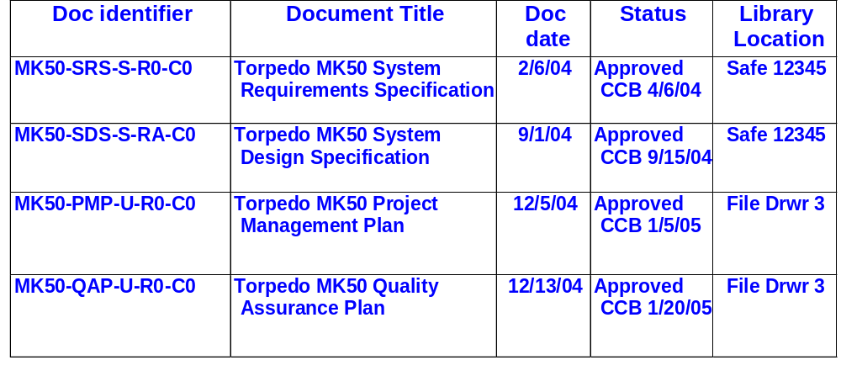
Configuration Status Accounting (4)
6: Perform Configuration Status Accounting
  C - Generate CSA Reports (sample reports)
  Record of Approved Configuration Documentation and ID Numbers

Slide 43
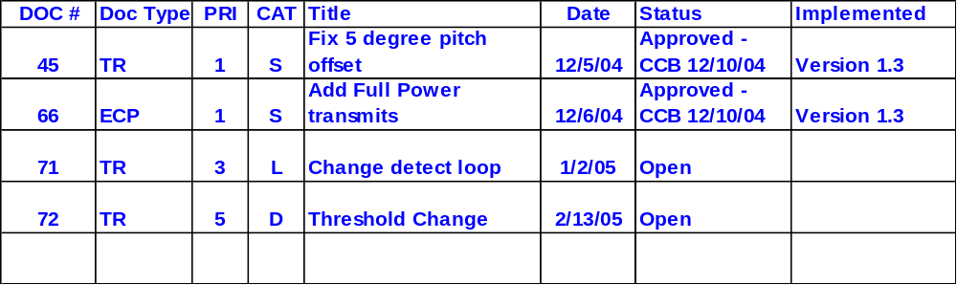
Configuration Status Accounting (5)
6: Perform Configuration Status Accounting
  C - Generate CSA Reports. (sample reports continued)
Status of proposed changes, deviations, and waivers to the configuration
D - Report any deficiencies against this activity
Improve the process!

Slide 44
Perform Configuration Audits and Reviews
7: Perform Configuration Audits
Formal Audit Types
  - Functional Configuration Audit (FCA)
  The formal examination of functional characteristics of a configuration item, prior to acceptance, to verify that the item has achieved the requirements specified in its functional and allocated configuration documentation. Functional Characteristics are quantitative performance parameters and design constraints, including operational and logistic parameters and their respective tolerances. Functional characteristics include all performance parameters, such as range, lethality, reliability, maintainability, and safety
  - Physical Configuration Audit (PCA)
  The formal examination of the “as built” configuration of a configuration item against its technical documentation to establish or verify the configuration item’s product baseline.
  - FCAs and PCAs are described in MIL-HDBK-61A

Slide 45

Configuration Audits and Reviews
7: Perform Configuration Audits
  CM support for configuration audits:
    Assist in the audit
    Review audit checklist
    Prepare CM reports, logs or records required to support the audit
    Establish and maintain baseline specifications and product files
    Follow up on audit reports to assess possible CM impact
    Provide storage for audit documentation, records and products
    Ensure audit report action items are resolved

Slide 46

Monitor and Control the CM Process
8: Monitor and Control the CM Process
  The CM Group should periodically monitor and review the CM
  Process as described in its CMP and supporting procedures:
    - Are the processes being followed, and if not, why not (too
    complicated, not adequate, don’t reflect current requirements,
    etc.)?
    - Is the current level of CM training adequate, or is there a need
    for refresher training or revised training to reflect process or
    tool changes?
    - Are deviations being made from the existing process? If so,
    are they being recorded and appropriately resolved?

Slide 47
Objectively Evaluate Adherence
9: Objectively Evaluate Adherence
  Request participation by QA and other project CM Subject Matter Experts (SMEs) to periodically review project adherence to the CM Process:
    “Objective” evaluation requires that the review is made by someone independent of the project organization
    Results of the review should be reported to the CM Manager and the Project Manager
    Review agenda should include both adherence to the existing process, and adequacy of the existing process to support effective CM
    - SMEs should have latitude to use their own experience, lessons learned to suggest improvements in processes, or propose alternative solutions to CM approaches

Slide 48
Review Status with Higher-Level Management
10: Review Status with Higher Level Management
  The CM Group periodically reports to higher-level management the activities, status and results of the CM Process, and resolves issues:
    Include reporting of identified process performance metrics (number of changes received/implemented, number of trouble reports received/resolved/status, etc.)
    Include action items resulting from previous informal CM audits or from independent reviews of CM Process
    Review planned versus actual accomplishment of CM scheduled activities, and compare estimated versus actual costs (labor, materials, etc.)

Slide 49
Collect Improvement Information
11: Collect Improvement Information
  Process improvement is a continuing activity, and applies to maintaining effective CM:
    Review performance metrics for indications of effective procedures or suggested improvements
    Log “lessons learned” from applying the CM approach within the project; apply these lessons to subsequent CM evolutions as process improvements
    Obtain further objective verification of the effectiveness of changes to CM Process – did the “improvements” actually realize measurable process performance?

Slide 50
8. What is Data Management? How is it related to CM?
Data is essentially anything other than hardware, software and interfaces
Among others, it provides proof of achievement, completion, status, support, and outputs.
  Examples:
    Process – lessons learned, work flow, statistical process data
    Managerial – costs, status, performance, resources
    Financial – EVM Reports, CLIN Funding, Funds Tracking
    Technical – engineering notebooks, development files
    Engineering - drawings, documents, source code, listings, defects
    Administrative – HR / Personnel data
    Security – keys, access card data, protocols
    Procurement – orders, transfers, receipts, invoices
DM helps CM with managing and controlling data
Notes:
Data in its simplest forms include concepts, thoughts opinions, values (any thing with characteristics, numbers, etc)
It its most complex forms it includes engineering drawings, maps, sounds, pictures.
Data about data (meta data – attributes and characteristics about the data) all of the information that makes data understandable
Financial – Earned Value, Est To Complete’s, Est. at Completion, Contract Line Item Number Funding

Slide 51

9. What if CM is performed by a contractor?
  Should your project’s Configuration Management function be partially or completely subcontractor supported:
    Use these same guidelines to establish subcontractor performance requirements
    Employ Government CM/QA representation to verify compliance of subcontractor activities with CM plans and procedures
    Document and resolve discrepancies in performance in the same manner as you would government personnel-supported CM

Slide 52

Implementing CM: REVIEW
  Determine the level of CM support required
  Develop or tailor a CM Process
  Develop a CM Plan
  Manage the implementation of CM
  Train all project personnel in their respective roles for supporting CM
  Perform the CM functions: identification, control, reporting, audits
  Monitor the effectiveness of the CM Process
  Get objective verification that the process is being followed, and is effective
  Review the status of CM activity with higher-level management
  IMPROVE THE PROCESS

Slide 53
10. Where can I get more information on CM?
  SEPO and its Process Asset Library at http://sepo.spawar.navy.mil/ contain all the information needed to implement CM!!
  Thank you for your attendance to this SPIWG!
  ANY QUESTIONS?
CM
Please fill out your SPIWG evaluation

Slide 54
Additional Materials
CM Process (Expert Mode)
Selecting a CM Tool
Sample (and simplified) CM Tool Selection Matrix
System Configuration Identification Hierarchy
Sample Baseline Change Process
More Sample Configuration Status Accounting Reports
More on CM Audits and Reviews
More on Configuration Identification

Slide 55
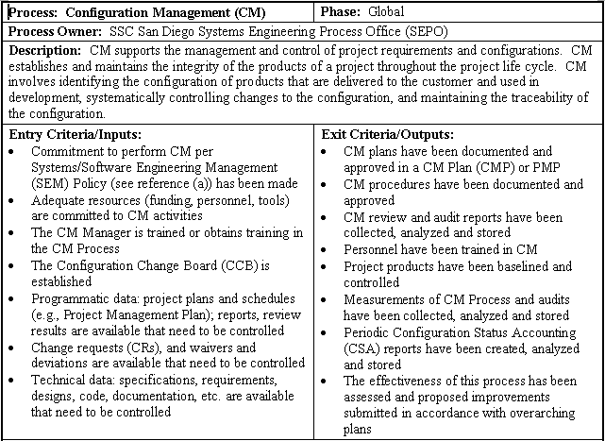
CM Process (Expert Mode)
PRX-CM-01 v1.3 Configuration Management Process (Expert Mode) 11/29/05
Notes:
In our overview of CM that we present in our Project Management Core course, we highlight the “Expert Mode” for CM, a kind of engineer’s gouge sheet that describes the basic elements of the CM process here at SSC San Diego.
(Describe briefly the elements of the expert mode, and describe how they summarize the elements of implementing CM).

Slide 56
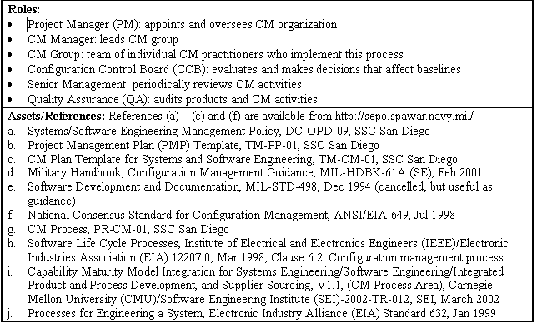
CM Process (Expert Mode) (2)
Notes:
This expert mode includes a brief description of the players in CM, and the resources they can draw upon to implement or maintain CM on their project.

Slide 57
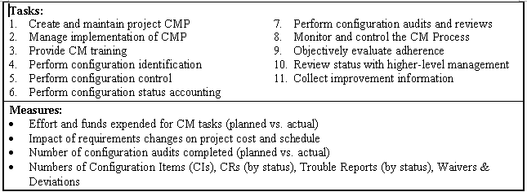
CM Process (Expert Mode) (3)
Notes:
But now, in this Practitioner’s training module, let’s focus on the tasks of the Expert Mode, the actual steps you must take to successfully implement CM here at SSC San Diego.

Slide 58
Implementing the CMP – Selecting a CM Tool
2: Manage Implementation of CMP
There are many – use the Decision Analysis and Resolution Process on the SSC San Diego PAL to facilitate Tool Selection
When considering the purchase of a CM tool, ask yourself:
  Will it fit my current process?
  What functions should it support?
    Engineering Change Proposal/Trouble Report (ECP/TR) record/archive/traceability
    CM Library access control
    Configuration Status Account Reporting
  Does it interface with existing tools (requirements management, project management, scheduling, estimation)?
  Is the tool fully supported (documented, with available technical training/support)?
  Are other projects using the tool, or having used the tool, do they recommend for/against its purchase (check with SEPO)?
  Does the facility it provides make it cost-effective when compared to standard tried-and-true methods?
Record your tool “lessons learned”

Slide 59
Implementing the CMP – Select CM Tool (2)
2: Manage Implementation of CMP
EXAMPLE: Your project needs a web-based program to maintain the status of problem reports;
BRAND X It’s Cheap Looks Easy to Use Stands alone (no interface with other DBs) No one has used it | BRAND Y Costs a little more Has a good user manual Others find it OK Interfaces with Requirements DB | BRAND Z Most expensive On-line tech support (for a fee) Larger projects use & LIKE Interfaces with multiple DBs and other tool sets
WHICH DO YOU BUY, AND WHY?

Slide 60
System Configuration Identification Hierarchy
System - Collection of hardware and
software to perform a designated
function with specified results.
System
Segment / subsystem - A grouping of elements that are closely related, often physically connected.
Segment/
Subsystem
CI - Configuration Item, responsible for one top level function (also, CSCI for computer software, HWCI for hardware).
CI
Unit
Unit - a major subdivision of a CI, a
component of that subdivision (a class, object,
module, function, routine, or database). Units
may occur at different levels of a hierarchy and may
consist of other units. Units in the design
may or may not have a 1-to-1 relationship.
Unit
Notes:
Before doing the Identification task, the system must be decomposed. The idea is to make it adaptable to multiple development paradigms - particularly OOD. (Mention some of the new uses cited in the paragraph.)
1. The customer should specify its control over the functional and performance rqmts and should retain the authority to approve the selection of CIs for the project.

Slide 61
Configuration Control (10)
5: Perform Configuration Control
D - Implement a Baseline Change Process (Example) (cont’d)
Need for
change
Change Request generated
Evaluation
more info needed
ok
Change report generated
Engineering change order generated
accept
CCB
decision
reject
Place on queue for change
Requestor is informed
Other CM
tasks
Notes:
Although highly simplified, this chart shows the typical flow of activity when generating, reviewing, approving and implementing changes.
Developing a workflow process chart may help you to pinpoint discrepancies or shortfalls in your existing process, or if starting a new process, may help you visualize a proposed process and the relationship of tasks.

Slide 62
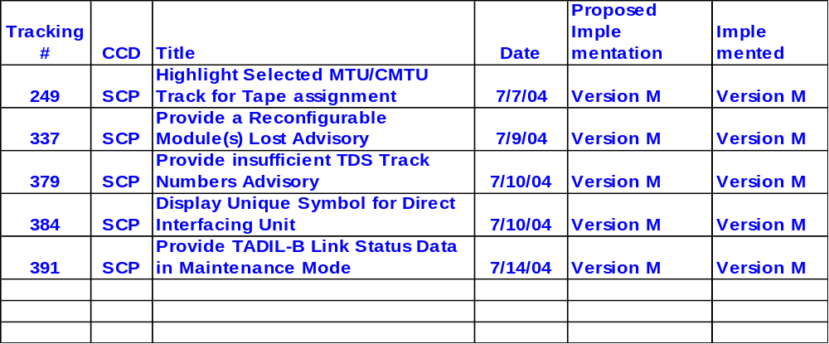
Configuration Status Accounting (6)
6: Perform Configuration Status Accounting
  C - Generate CSA Reports. (sample reports)
  Implementation status of approved changes

Slide 63
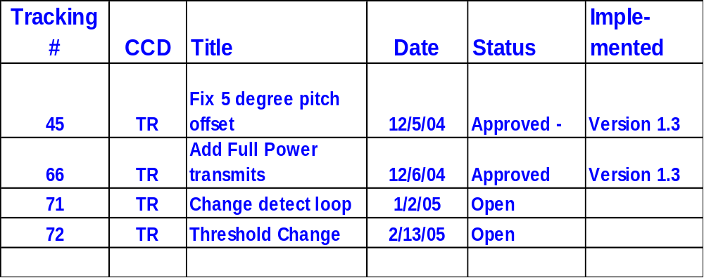
Configuration Status Accounting (7)
6: Perform Configuration Status Accounting
  C - Generate CSA Reports. (sample reports)
  Product Baseline for Release Version 1.3

Slide 64
Configuration Status Accounting (8)
6: Perform Configuration Status Accounting
  C - Generate CSA Reports: Field Requests for CSA Reports
    - Requests for CSA reports originating outside the project are
    directed for approval to project management which authorizes
    need-to-know access
    - CM should provide on a periodic basis or allow access to CSA
    Reports to all members of the project
    - CM maintains the CSA Report Distribution list

Slide 65
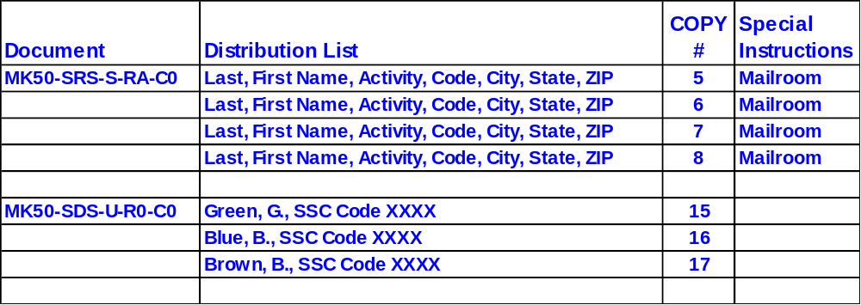
Configuration Status Accounting (9)
6: Perform Configuration Status Accounting
  C - Generate CSA Reports: Field Requests for CSA Reports.(cont’d)
    CSA Report Distribution list (sample)

Slide 66

Configuration Audits and Reviews (2)
7: Perform Configuration Audits
  Required Plan documentation to conduct FCA/PCA:
    - An FCA/PCA Plan is written to identify the items listed below:
      The specific tasks and procedures to accomplish
      these audits
      The documents, hardware, software and test sets
      required for performing the audits and what is to be examined
    - The resulting FCA/PCA Report includes the items listed below:
      The results of the audit findings
      Resolution of open issues or action items

Slide 67
Configuration Audits and Reviews (3)
7: Perform Configuration Audits
  Typical Scheduling of FCA/PCA:
    - FCA:
      After a major change or significant numbers of minor
      changes have occurred or before the establishment of the
      Product Baseline
    - PCA:
      Concurrently with the FCA or immediately following an FCA
  NOTE: IF the project maintains effective CM control, the FCA/PCA should be a SLAM DUNK!

Slide 68
Configuration Audits and Reviews (4)
7: Perform Configuration Audits
  Requirements Traceability Matrix (RTM) – an important tool to conduct
  an FCA/PCA:
    - Provides traceability of all system/hardware/software
    requirements from highest level specification down through
    development and testing
    - Ensures that no product development is made without a
    supporting specification
    - Ensures that all product specifications are tested
  Test Reports
    - Ensure that test reports identify the requirements tested
    Ensure that all test reports are witnessed/signed as
    accomplished, and that report content complies with system
    development and testing plans

Slide 69
Configuration Audits and Reviews (5)
7: Perform Configuration Audits
  Other periodic informal CM audits:
    - Performed as deemed appropriate by the project manager
    - CM Audits. Independent audit of CM processes, procedures, and
    products to ensure that the CM program complies with the
    requirements of the CMP
    - CM Reviews. Internal review to determine how effectively and
    efficiently the CM process and procedures fulfill the CM
    requirements as defined in the CMP. Includes verification of
    products generated by CM
    - QA typically conducts or assists with both formal and informal
    audits

Slide 70
Configuration Audits and Reviews (6)
7: Perform Configuration Audits
  Documentation from formal and informal CM audits (CM Deficiency
  Report):
    - Identify noncompliance with CM processes, procedures, and
    products against requirements of the CMP
    - Identify areas for improving effectiveness and efficiency in CM
    processes and procedures
    - Provide results of verifying products generated by CM (e.g.,
    status reports, change requests forms, etc.)

Slide 71

Configuration Identification (2)
4: Perform Configuration Identification
What types of configuration documentation are required for each CI (System), Program/Project?:
  CI System Design
  System/Segment Architectural Design
  System Interface Design
  Database Design
  Program/Project Planning
  Project Management Plan (PMP), and/or
  Software Development Plan (SDP), and/or
  Systems Engineering Management Plan (SEMP)
  Test Plan (TP)
  System Integration Plan
  Configuration Management Plan (CMP)
  Quality Assurance Plan (QAP)
Notes:
Make sure that all your system-related components are identified and controlled. Program/Project planning documents are also identified and kept under CM

Slide 72
Configuration Identification (3)
4: Perform Configuration Identification
What other types of configuration documentation are
required for each CI (System), Program/Project? :
  CI Requirements
  Requirements Specification
  Subsystem/Unit Architectural Design
  Detailed Design
  Technical Drawings, Diagrams, Blueprints
  System/Subsystem/Unit Assembly
  Product Integration Plans
  Unit/Subsystem/System Test Descriptions
  Test Reports
  Version Description Documents
  Product User Guides
  Product Maintenance Guides
  Equipment Specifications
  Environmental Requirements (space, power, temperature, etc.)
  Safety, Security, Hazardous Material Control Requirements
Notes:
All documentation used to support the engineering of the software should be included in this list.

